Slide 1



Project Future 12:
Data Engineering & Business Intelligence
Project Assignment: Melodica Business Intelligence Pipeline
Team 4
George Kapelos
Dimitris Loukakis
Ioannis Karelas
Georgios Avgeridis
Anastasios Kakos

Slide 2

Project Outline
Client: Melodica Media Corporation , online music store company based in California, US.
Task: Implement an end-to-end Business Intelligence pipeline to analyze track sales.
Objective: Support business decision-making through clear and reliable sales insights.
Data: Transactional sales data sourced from the Chinook OLTP database.
Solution: Data pipeline including staging area, data warehouse and automated ETL processes.
Outcome: Interactive Power BI dashboards that provide clear views of sales performance across multiple dimensions.

Slide 3
Table of contents
01
02
03
04
OLTP
Staging
Provided data
SQL Scripts to create and load the Staging Area
Data Warehouse
Power BI
SQL scripts to create the DW and load it from the staging area
Interactive sales analysis dashboard

Slide 4
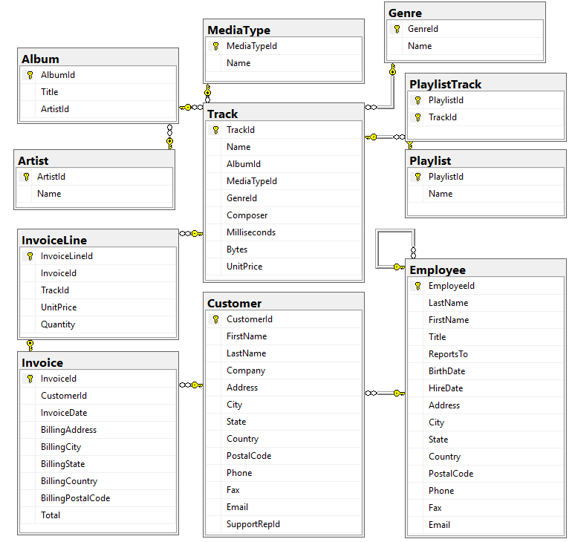
Imported data (OLTP)
Data Source: Using the Chinook database as Melodica's main transactional (OLTP) system.
Analysis Scope: Focusing on the Tracks, Invoices, Customers, and Employees entities.
Complexity: Visualizing the initial relationships (Normalization) before transforming them into an analytical model.

Slide 5
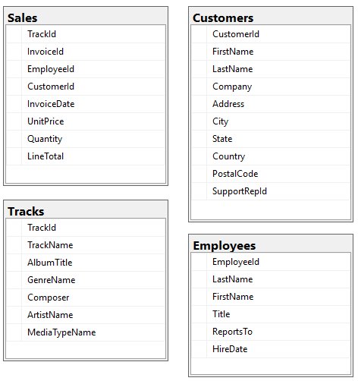
Staging area
Purpose: Temporary landing zone
Supports: Reliable loading
Copy: Original data
Duplicate: Customers, Employees
Join: Album, Artist, Media Type, Genre in Tracks
Join: Invoice and Invoice Line in Sales

Slide 6
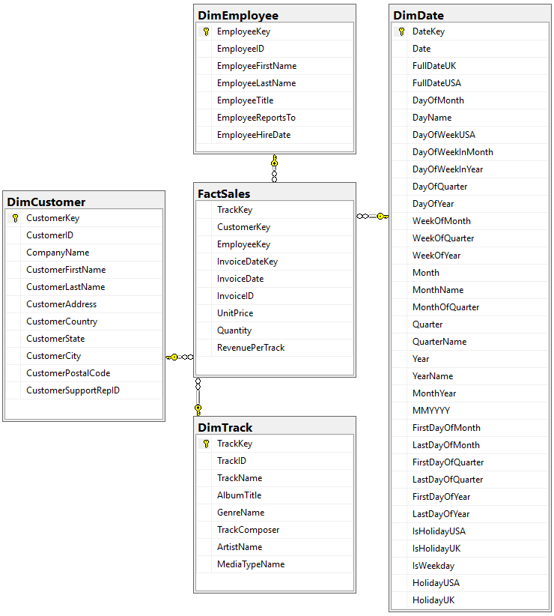
Data Warehouse
Purpose: Optimized data for analytics and reporting
Model Type: Star schema
Key Table: Fact Sales
Add: Table with Dates
DimDate: Holds Details about Time
Purpose: Analytics based on Date
Connections: Via Single Foreign Key

Slide 7

Microsoft Power BI
Objective
Analyze digital music sales performance
Identify revenue trends, customer behavior & catalog insights
Support business and management decision-making
Dashboard Structure
Dashboard Home
Time
Performance
Track & Genre Analysis
Customer Performance & Trends
Employee / Support Rep

Slide 8

Interactive Dashboard Walkthrough
Interactive Power BI dashboard showcasing all analytical views and drill-down capabilities.

Slide 9
Business Value
Key Insights
Faster access to sales insights without manual reporting
Clear visibility into trends across time, genres, and regions
Improved support for data-driven business decisions
Consistent and repeatable reporting based on a standardized data foundation
Identification of top-selling music genres and artists
Sales trends by month and year
Differences in sales performance across countries
Detection of seasonal patterns and peak sales periods

Slide 10
Tech Stack Overview
Git, Github
SQL
SQL Server Management Studio
Power BI

Slide 11
Challenges
Not all team members had prior experience with Git-based workflows, which required additional coordination and guidance to ensure consistent versioning and file uploads.
Power BI KPI visuals rely on the last data point, which required careful date granularity selection to avoid misleading results.
A significant portion of the music catalog has zero sales, which impacts revenue concentration analysis.

Slide 12
Future Work
SSIS for automation
Deployment in Cloud
Implement forecasting models for revenue and sales trends
Dynamic and adjustable targets using What-If parameters

Slide 13

Thank you!
Github: https://github.com/tasos-kakos/PF12_team4

